Slide 1

Chapter 5 Freedom of Expression
Ethics in Information Technology, Second Edition
Updates by Carlotta Eaton, NRCC

Slide 2
Objectives
What is the legal basis for the protection of freedom of speech in the United States, and what types of speech are not protected under the law?
In what ways does the Internet present new challenges in the area of freedom of expression?
What key free-speech issues relate to the use of information technology?

Slide 3
First Amendment Rights …
Right to freedom of expression
Important right for free people everywhere
Guaranteed by the First Amendment
Definition of free speech includes
Nonverbal, visual, and symbolic forms of expression
Right to speak anonymously

Slide 4
First Amendment Rights
Not protected by the First Amendment
Obscene speech
Defamation
Incitement of panic
Incitement to crime
“Fighting words”
Sedition

Slide 5
Obscene Speech
Speech is considered obscene when
Average person finds the work appeals to the prurient interest
Work depicts or describes sexual conduct in an offensive way
Lacks serious literary, artistic, political, or scientific value

Slide 6
Defamation
Publication of a statement of alleged fact that is
False
Harms another person
Harm is often of a financial nature
Slander
Oral defamatory statement
Libel
Written defamatory statement

Slide 7
Freedom of Expression: Key Issues
Controlling access to information on the Internet
Anonymity
Defamation
Hate speech
Pornography

Slide 8
Controlling Access to Information on the Internet …
Freedom of speech on the Internet is complicated by children’s access
Communications Decency Act (CDA)
Aimed at protecting children from online pornography
Broad language and vague definition of indecency
Found unconstitutional in 1997

Slide 9
Controlling Access to Information on the Internet …
Child Online Protection Act (COPA)
Applies to communication for commercial purposes
Imposes penalties for exposing minors to harmful material on the Web
Found unconstitutional in 2004
Internet filter
Software installed with a Web browser
Blocks access to certain Web sites that contain inappropriate or offensive material

Slide 10
Controlling Access to Information on the Internet …
URL filtering
Blocks URLs or domain names
Keyword filtering
Blocks key words or phrases
Dynamic content filtering
Web site’s content is evaluated immediately before being displayed
Uses
Object analysis
Image recognition

Slide 11
Controlling Access to Information on the Internet …
Popular Internet filters
ContentProtect
CYBERsitter
NetNanny
CyberPatrol
HateFilter

Slide 12
Controlling Access to Information on the Internet …
ICRA rating system
Questionnaire for Web authors
Generates a content label
Uses Platform for Internet Content Selection (PICS) standard
Users can configure browsers to read the label to block content
Relies on Web authors to rate their site
Complement to other filtering techniques

Slide 13
Controlling Access to Information on the Internet
ISP blocking
Blocking is performed on the ISP server
ClearSail/Family.NET prevents access to certain Web sites

Slide 14
Legal Overview: Children’s Internet Protection Act …
Federally financed schools and libraries must block computer access to
Obscene material
Pornography
Anything considered harmful to minors
Schools and libraries subject to CIPA do not receive Internet access discounts unless they certify that Internet safety measures are in place
Required to adopt a policy to monitor the online activities of minors

Slide 15
Legal Overview: Children’s Internet Protection Act (CIPA) …
CIPA does not require the tracking of Internet use by minors or adults
Acceptable use policy agreement is an essential element of a successful program in schools
Signed by
Students
Parents
Employees

Slide 16
Legal Overview: Children’s Internet Protection Act (CIPA)
Difficulty implementing CIPA in libraries because their services are open to people of all ages
Including adults with First Amendment rights

Slide 17
Anonymity …
Principle of anonymous expression
People can state opinions without revealing their identity
In the wrong hands, it can be a tool to commit illegal or unethical activities
Anonymous remailer service
Computer program that strips the originating address from the e-mail message
Forwards the message to the intended recipient
Ensures no header information

Slide 18
Anonymity
John Doe lawsuit
Identity of the defendant is temporarily unknown
Common in Internet libel cases
Defendant communicates using a pseudonym or anonymously
ISPs subpoenaed to provide the identity
By filing a lawsuit, the company gains immediate subpoena power

Slide 19
National Security Letters …
Requires financial institutions to turn over the electronic records of
Suspected terrorists
Spies
USA Patriot Act allows the FBI to use NSLs to obtain records from banks and other financial institutions if they are sought for an intelligence or terrorism investigation

Slide 20
National Security Letters
USA Patriot Act includes a gag provision
Firm cannot inform customers of the investigation
Intelligence Authorization Act for Fiscal Year 2004
Expanded the scope of discovery beyond financial institutions
Now includes ISPs

Slide 21
Defamation and Hate Speech …
Actions that can be prosecuted include
Sending threatening private messages over the Internet to a person
Displaying public messages on a Web site describing intent to commit acts of hate-motivated violence
Libel directed at a particular person

Slide 22
Defamation and Hate Speech
Some ISPs voluntarily agree to prohibit subscribers from sending hate messages
Does not violate subscribers’ First Amendment rights
ISPs must monitor the use of their service
Take action when terms are violated

Slide 23
Pornography …
The Internet has been a boon to the pornography industry
More than 60,000 Web sex sites are accessible
The sites generate at least $1 billion a year in revenue
CAN-SPAM Act
Deterrent in fighting the dissemination of pornography

Slide 24
Pornography
Reasonable steps to stop access in the workplace
Establishing a computer usage policy
Prohibiting access to pornography sites
Identifying those who violate the policy
Taking action against those users
Numerous federal laws address child pornography
Federal offense

Slide 25
Summary Assessment Questions
Chapter Page 162

Slide 26
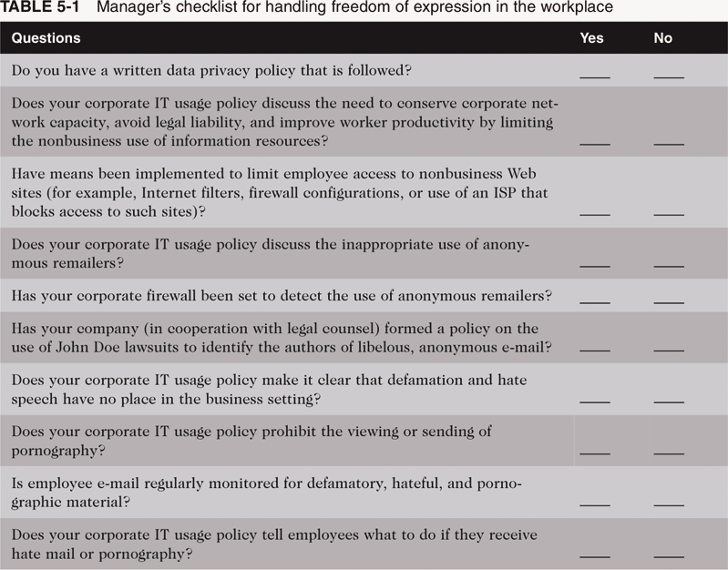
Manager’s Checklist for Handling Freedom of Expression in the Workplace

Slide 27
Summary
First Amendment protects the right to
Freedom of religion
Freedom of expression
Key issues:
Controlling access to Internet information
Anonymous communication
National Security Letter (NSL)
Spread of defamation and hate speech
Access to pornography

